Slide 1
Motivation at Work
    Copyright ©2005 by South-Western, a division of Thomson Learning. All rights reserved.

Slide 2
Motivation Concepts and Theories
Motivation— the process of arousing and sustaining goal-directed behavior, factors within and outside an organism that cause it to behave a certain way at a certain time
Drive—an internal condition or impulse
that activates behavior to reduce a need
and restore homeostasis
Incentive—external goal that “pulls” or “pushes” behavior
Notes:
Keywords: motivation, motivational state, drive, incentive
Homeostasis- the tendency towards a relatively stable equilibrium between interdependent elements, especially as maintained by physiological processes.

Slide 3
Motivation: Its Basic Components
Arousal
Direction
Maintenance
Goal
Good
impression
made
Compliment work Persist
Desire to
make a good
impression
Work extra hard Persist
Do special favors Persist
3

Slide 4
Theories of Motivation
Instinct—motives are innate
Drive—biological needs as motivation
Incentive—extrinsic things push or pull behavior
Arousal—people are motivated to maintain optimum level of arousal
Humanistic—hierarchy of needs

Slide 5
3 Groups of
Motivational Theories
Internal
  Suggest that variables within the individual give rise to motivation and behavior
  Example: Maslow’s hierarchy of needs theory
Process
  Emphasize the nature of the interaction between the individual and the environment
  Example: Expectancy theory
External
  Focus on environmental elements to explain behavior
  Example: Two-factor theory
Notes:
3

Slide 6

Maslow’s Hierarchy of Needs
SA
Esteem
Lowest to highest order
Love (Social)
Safety & Security
Physiological
Notes:
6
4
2
2
2
5
Abraham Maslow suggested that motives are divided into several levels from basic survival needs to psychological and self-fulfillment needs.
Abraham Maslow suggested that motives are divided into several levels--from basic survival needs to psychological and self-fulfillment needs

Slide 7
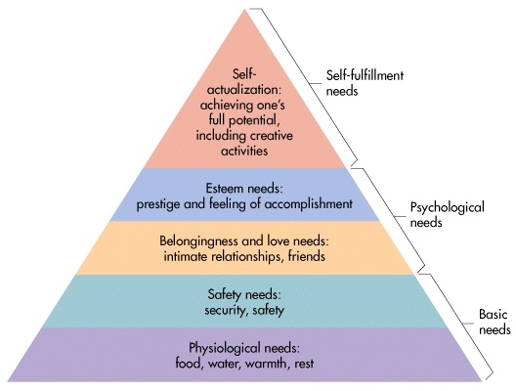
Notes:
Discovering Psy 2e Figure 8.1 p. 281

Slide 8
Basic Emotions
Fear, surprise, anger, disgust, happiness, sadness
Basic emotions are innate and “hard-wired”
Complex emotions are a blend of many aspects of emotions
Classified along two dimensions
  Pleasant or unpleasant
  Level of activation or arousal associated with the emotion

Slide 9
Physical Arousal and Emotions
Sympathetic nervous system is aroused with emotions (fight-or-flight response)
Different emotions stimulate different responses
  Fear—decrease in skin temperature (cold-feet)
  Anger—increase in skin temperature (hot under the collar)

Slide 10
Emotion and Facial Expressions
Each basic emotion is associated with
a unique facial expression
Facial expressions are innate and “hard-wired”
Innate facial expressions the same across many cultures
Display rules—social and cultural rules that regulate emotional expression, especially facial expressions.
Notes:
Keywords: facial feedback theory, Ekman

Slide 11
Motivational Theories X & Y
SA
Theory Y - a set of assumptions of how to manage individuals motivated by higher order needs
Esteem
Love (Social)
Theory X - a set of assumptions of how to manage individuals motivated by lower order needs
Safety & Security
Physiological
Notes:
7
5
2
2
2
5

Slide 12
Considering these theories, how might companies motive their employees
What types of incentives would motivate employees
How can employers satisfy employees’ needs
Would the same type of incentives or rewards satisfy all employees?

Slide 13

McGregor’s Assumptions
About People Based on Theory X
Naturally indolent
Lack ambition, dislike responsibility, and prefer to be led
Inherently self-centered and indifferent to organizational needs
Naturally resistant to change
Gullible, not bright, ready dupes
Adapted from Table 5.1 which is from “The Human Side of Enterprise” by Douglas M. McGregor, reprinted from Management Review, November 1957. Copyright 1957 American Management Association International. Reprinted by permission of American Management Association International, New York, NY. All rights reserved. http://www.amanet.org.
Notes:
8
7

Slide 14
McGregor’s Assumptions
About People Based on Theory Y
Experiences in organizations result in passive and resistant behaviors; they are not inherent
Motivation, development potential, capacity for assuming responsibility, readiness to direct behavior toward organizational goals are present in people
Management’s task—arrange conditions and operational methods so people can achieve their own goals by directing efforts to organizational goals
Adapted from Table 5.1 which is from “The Human Side of Enterprise” by Douglas M. McGregor, reprinted from Management Review, November 1957. Copyright 1957 American Management Association International. Reprinted by permission of American Management Association International, New York, NY. All rights reserved. http://www.amanet.org.
Notes:
9
8

Slide 15
Alderfer’s ERG Theory
SA
Growth
Esteem
Relatedness
Love (Social)
Safety & Security
Existence
Physiological
Notes:
10

Slide 16
Need Theories: A Comparison
Growth needs
5. Self-actualization needs
Growth needs
4. Esteem needs
Deficiency Needs
3. Social needs
Relatedness needs
2. Safety needs
Existence needs
1. Physiological needs
Maslow’s need hierarchy theory
Alderfer’s ERG theory
4

Slide 17

McClelland’s Need Theory:
Need for Achievement
Need for Achievement - a manifest (easily perceived) need that concerns individuals’ issues of excellence, competition, challenging goals, persistence, and overcoming difficulties
Notes:
15
2
6
6
6
6

Slide 18
McClelland’s Need Theory:
Need for Power
Need for Power - a manifest (easily perceived) need that concerns an individual’s need to make an impact on others, influence others, change people or events, and make a difference in life
Notes:
16
2
6
6
6
6

Slide 19
McClelland’s Need Theory:
Need for Affiliation
Need for Affiliation - a manifest (easily perceived) need that concerns an individual’s need to establish and maintain warm, close, intimate relationships with other people
Notes:
17
2
6
6
6
6

Slide 20
3 Motivational Need Theories
Maslow
Alderfer
McClelland
Self-actualization
Growth
Need for
Achievement
Higher
Order
Needs
Esteem
self
interpersonal
Need for
Power
Belongingness
(social & love)
Relatedness
Need for
Affiliation
Lower
Order
Needs
Safety & Security interpersonal
physical
Existence
Physiological
Notes:
18

Slide 21
Herzberg’s Two-Factor Theory
Hygiene Factor - work condition related to dissatisfaction caused by discomfort or pain
  maintenance factor
  contributes to employee’s feeling not dissatisfied
  contributes to absence of complaints
Motivation Factor - work condition related to the satisfaction of the need for psychological growth
  job enrichment
  leads to superior performance & effort
Notes:
11
9

Slide 22
Motivation–Hygiene
Theory of Motivation
Company policy &
administration
Supervision
Interpersonal relations
Working conditions
Salary
Status
Security
Motivation factors increase job satisfaction
Achievement
Achievement recognition
Work itself
Responsibility
Advancement
Growth
Salary?
Hygiene factors avoid
job dissatisfaction
SOURCE: Adapted from Frederick Herzberg, The Managerial Choice: To be Efficient or to Be Human. (Salt Lake City: Olympus, 1982). Reprinted by permission.
Notes:
13
10

Slide 23
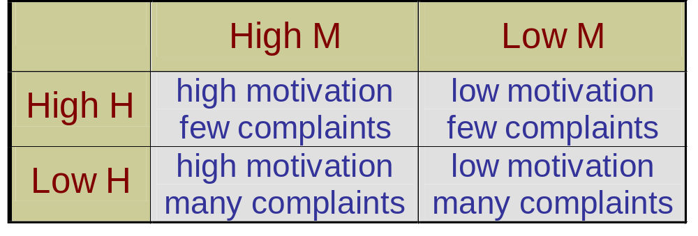
Motivation-Hygiene Combinations
(Motivation = M, Hygiene = H)
Notes:
14

Slide 24
3 Causes of
Motivational Problems
Belief that effort will not result in performance
Belief that performance will not result in rewards
The value a person places on, or the preference a person has for, certain rewards

Slide 25
Adams’s Theory of Inequity
Inequity - the situation in which a person perceives he or she is receiving less than he or she is giving, or is giving less than he or she is receiving

Slide 26
Motivational Theory of Social Exchange
Person Comparison
other
Equity Outcomes = Outcomes
Inputs Inputs
Negative Outcomes < Outcomes
Inequity Inputs Inputs
Positive Outcomes > Outcomes
Inequity Inputs Inputs
Notes:
19

Slide 27
Perceptions of how fairly
rewards are distributed
If Inputs = Outputs Satisfaction
Effort,
Motivation,
Performance,
Skills,
Expertise
Rewards
Bonus
Promotions
Pay Raise
Recognition
O
I
= 1

Slide 28
Equity Theory --
Compare I/O ratios to others
Self
Outcome
Input
Other
Outcome
Input
Satisfaction
=
Examples of Inequity
1. Underpayment = Self O/I > Other O/I
2. Overpayment = Self O/I < Other O/I

Slide 29
Strategies for
Resolution of Inequity
Alter the person’s outcomes
Alter the person’s inputs
Alter the comparison other’s outputs
Alter the comparison other’s inputs
Change who is used as a comparison other
Rationalize the inequity
Leave the organizational situation
Notes:
20
3
7
7
7
7

Slide 30
Expectancy Model of Motivation
Effort
Performance
Reward
Effort
Perceived effort–
performance
probability
Perceived
performance–
reward probability
Perceived
value of reward
“If I work hard,
will I get the job
done?”
“What rewards
will I get when
the job is well done?”
“What rewards
do I value?”
Notes:
25

